Slide 1


Solar City
Project Planning

Slide 2


Members:
1
Pratik Pingale (19CO056)
2
Solar City
Sagnik Roy (19CO061)
3
This project is based on the concept of Solar Energy and how that energy can be efficiently used in day-to -day life.
Creating a concept model is necessary so as to understand the basic need of Solar Energy and how it can be useful on large scale.
Rohan Dayal (19CO060)
4
Tanay Zope (19CO074)
5
Yash Tatiya (19CO067)

Slide 3
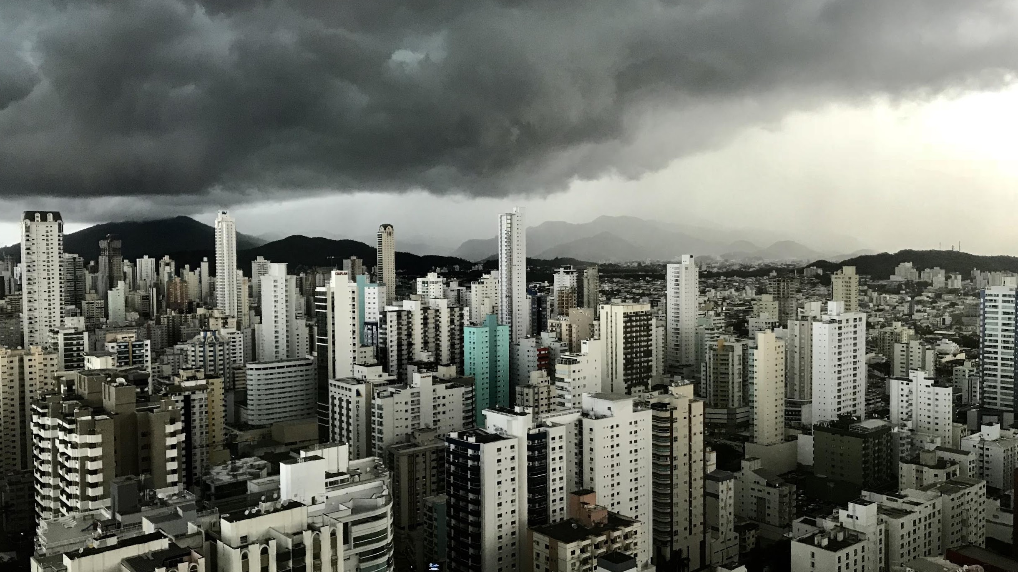
Project Plan
INVESTMENT
FILES EXCHANGE
FINANCIAL DATA
BUSINESS CASE
OVERVIEW
LEGAL DOCS.
DIALOG
BUDGET SPENDING
DEVELOP

Slide 4

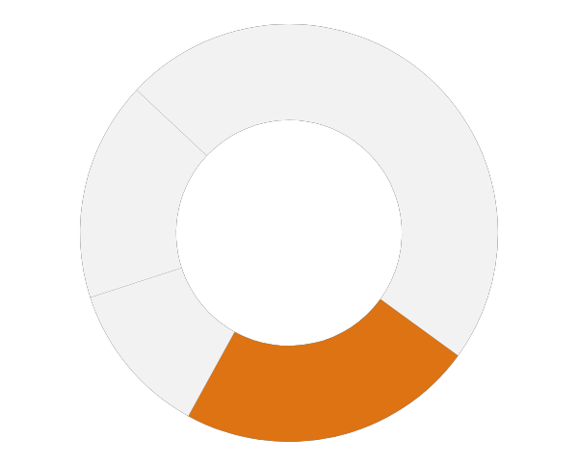

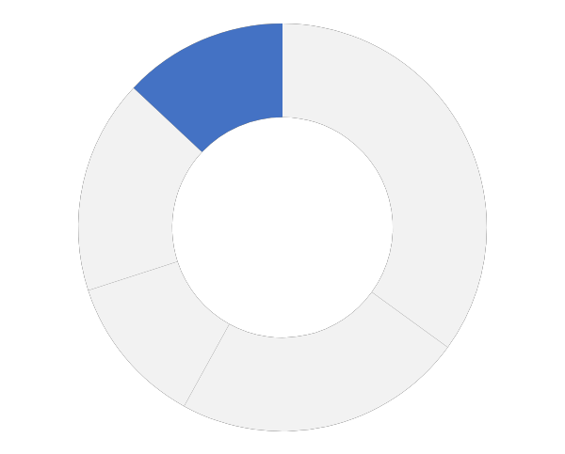


CONSTRUCTION
35%
23%
12%
13%
17%
SOLAR PANELS
AC/DC CONVERTER
HUMAN CONTRIBUTION
CHARGE CONTROLLER
BATTERY

Slide 5
WORKFLOW
Components
Collect and Combine all the components of the project.
COMBINE
Plot
BASE
Create the Plot of the project and make the Base of the Model.
Attach
Place and Attach all the components of the Model on the Base to create the Final Project.
FINAL MODEL
Working

Slide 6
WORKING
Collect
Distribute
Use
Using Solar Panels capture the Solar Energy during the daytime.
Step 1
For individual purpose one can store this Electrical Energy in their home.
Step 4
Step 2
Step 6
This current can now be transferred to all other local suppliers which will use this energy for other purposes.
This Solar Energy is converted to Electrical Energy in Solar Cells.
Step 3
Step 5
This Electrical Energy is then stored in Batteries or any other storage device.
For general purpose like Street Lights, this Electrical Energy is transferred to near-by Power Station

Slide 7
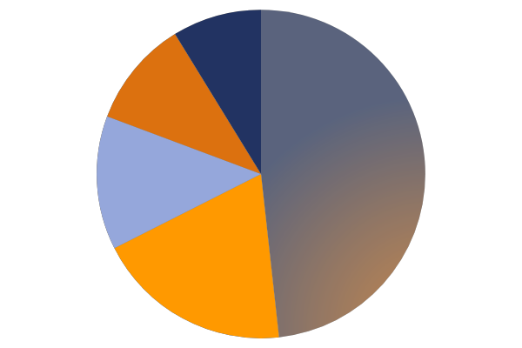
SURVEY OF INDIA
INDIAN ENERGY CONSUMPTION
NUCLEAR
1%
HYDRO
4%
8.8 Mtoe
31.86 Mtoe
Nuclear energy i.e. renewable energy source
Hydro electric source of energy is one of the major renewable energy source
COAL (56%)
452.26 Mtoe
SOLAR
15%
CRUDE OIL
22%
27.69 Mtoe
289.9 Mtoe
Solar energy source , the main focus of our project currently provides almost equal supply as hydro power
Crude oil and natural gas i.e. non renewable energy sources

Slide 8
SOLAR ENERGY USES IN OTHER COUNTRIES
53.26GW
North America
55.26GW
CHINA
130GW
AFRICA
11GW
INDIA
48.2GW
SOUTH AMERICA

Slide 9
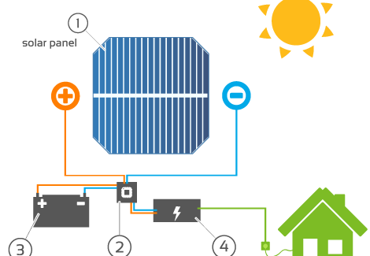
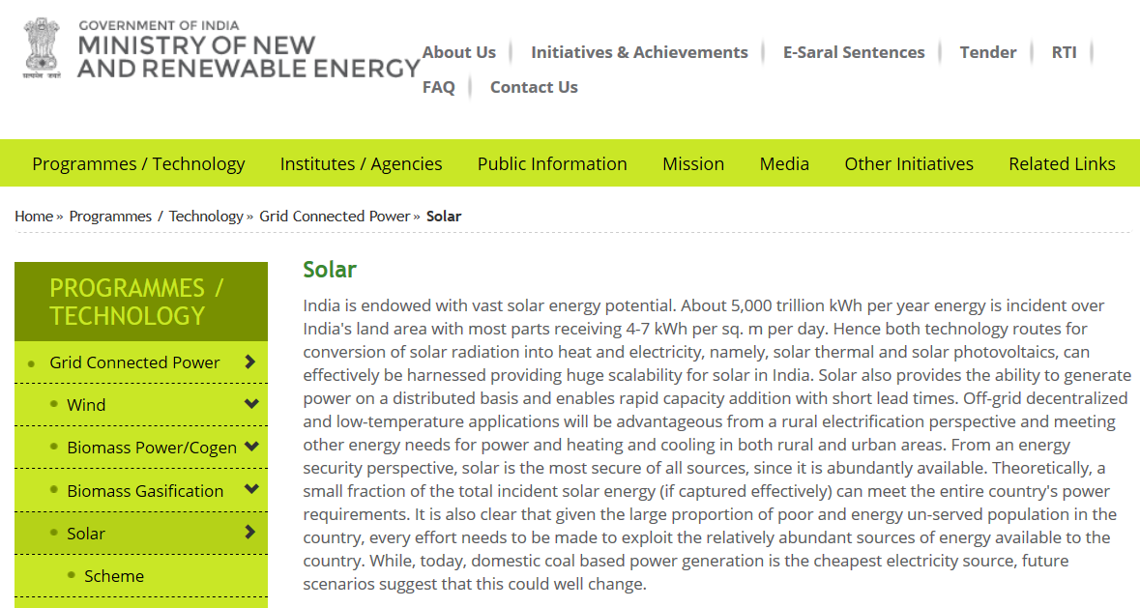
DOCUMENTATIONS AND SOURCES
before
http://www.quora.com
http://www.seminarsonly.com
https://www.encyclopedia.com
https://www.alldatasheet.com
https://mnre.gov.in
https://seci.co.in
after
after
Notes:
9

Slide 10
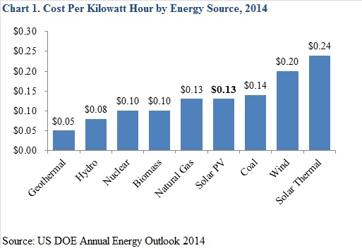
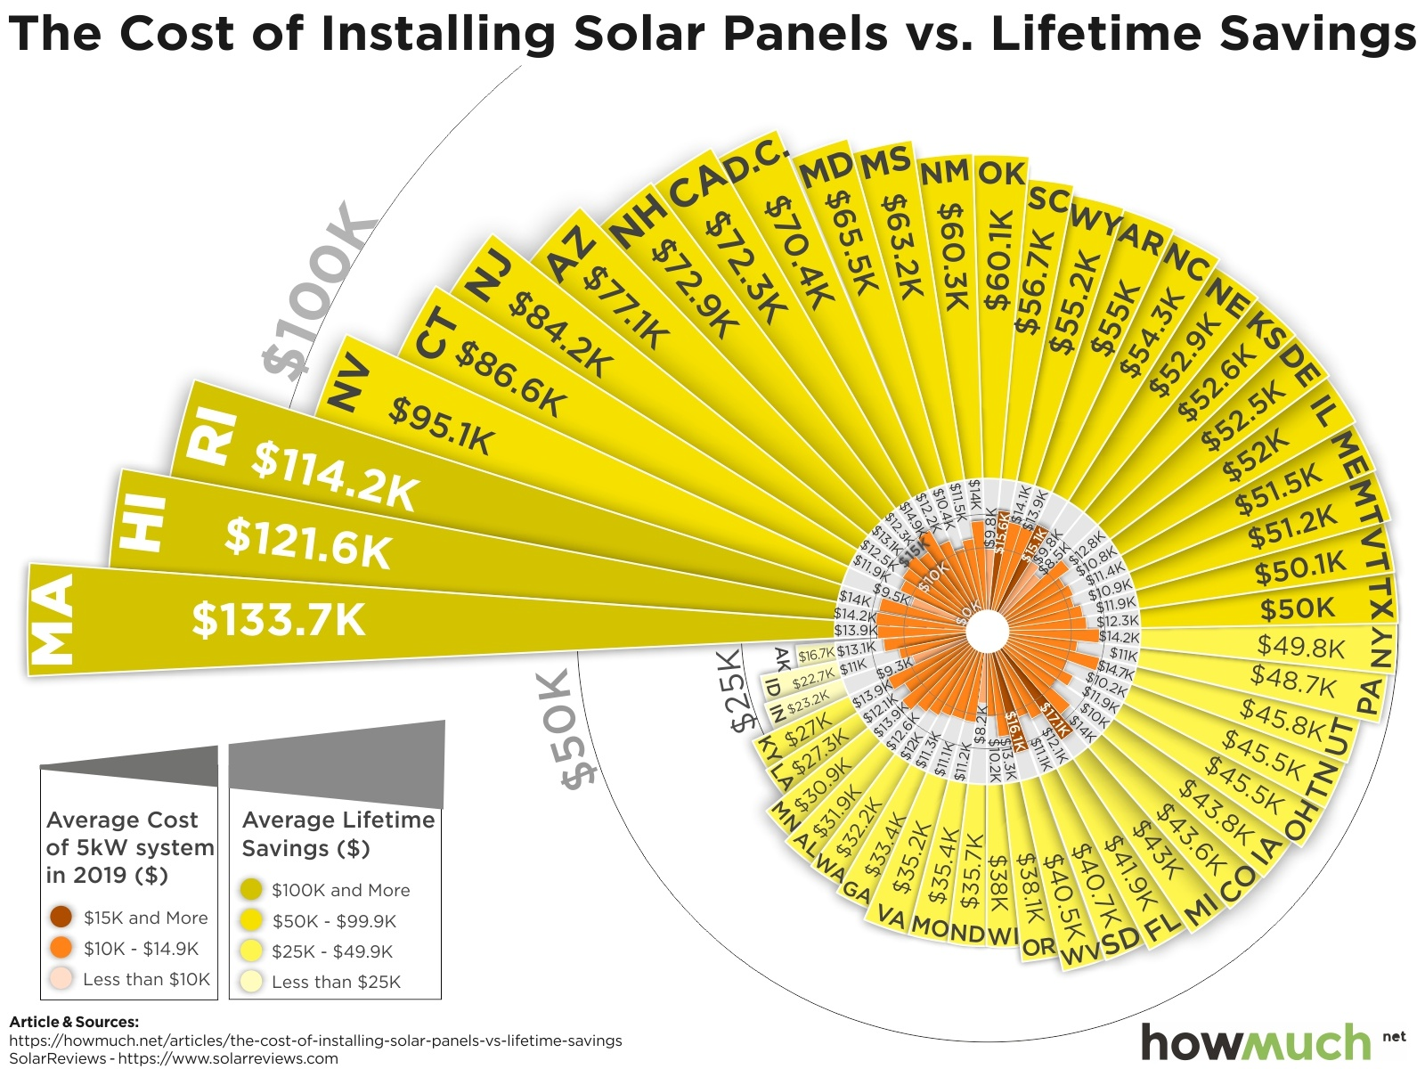
ADVANTAGES
As it is Renewable energy source it is an infinite source.
Solar energy is quite Energy Efficient as we will see now.
As Energy Efficiency increases Cost Effectiveness also increases.
Use of Solar energy is quite Diverse.
Effect of Solar energy on our environment is quite low.

Slide 11
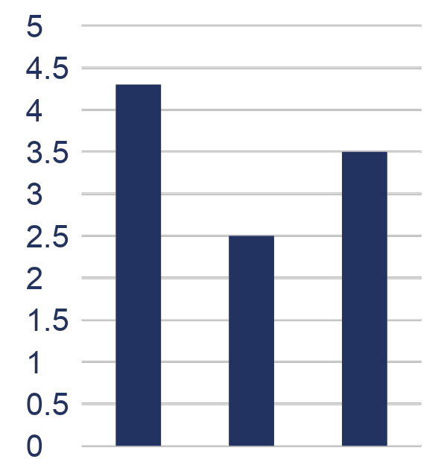
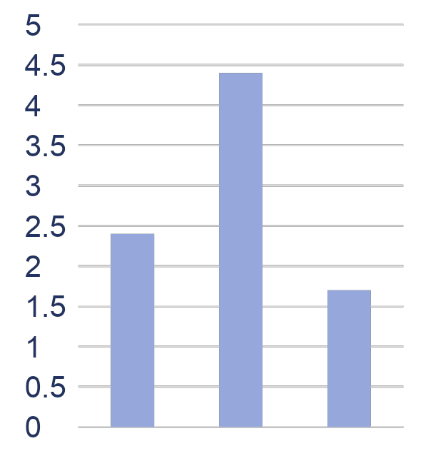
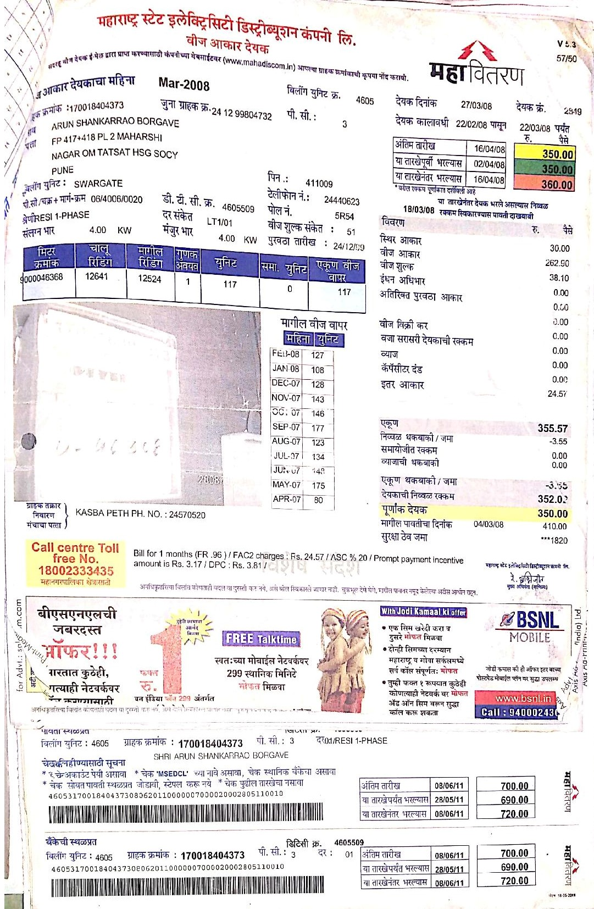
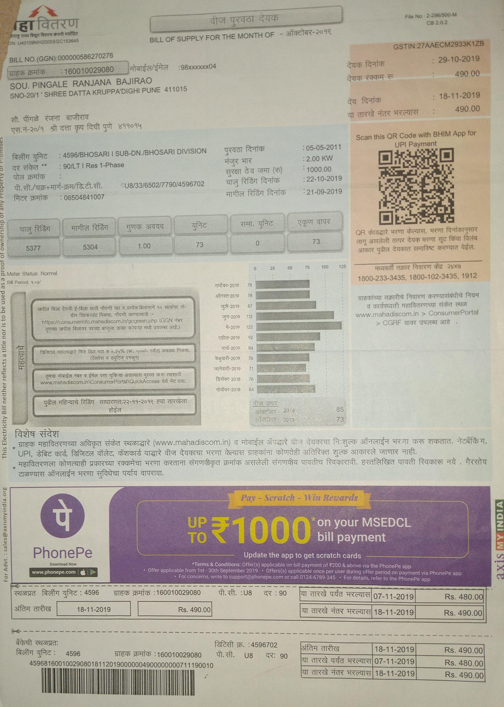
BUSINESS CASE
COST
Market
VALUE
Per kWh
30%

Slide 12
CONCLUSION OF THE PROJECT PLAN
Successfully reduce the cost of clean energy.
Set up charging station for fleet of fuel efficient vehicles.
Accurately brought down homeowners electricity bill per month.
Serves 14 states, 25000 customers with 25 local operating centers.
Helps the environment by wasting less energy and requiring less new energy production (energy efficiency).
Recognized with environmental leadership awards by Aspen Institute and Actera.
Recognized as the a Green Power Supplier of the year by DOE in 2010.
Notes:
12

Slide 13

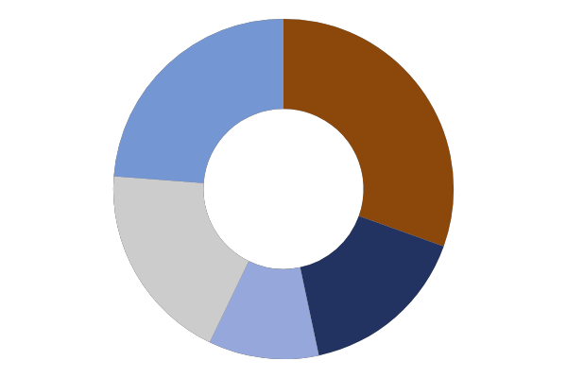
KEY POINTS
FLOURISHING
OPPORTUNITY
SHORT_TERMISM
PERSISTENT
NECESSITY
COMPELLING

Slide 14

THANK YOU

